Slide 1
Intermediate- sql-2

Slide 2
Materialized Views
Materializing a view: create a physical table containing all the tuples in the result of the query defining the view
If relations used in the query are updated, the materialized view result becomes out of date
Need to maintain the view, by updating the view whenever the underlying relations are updated.

Slide 3
Syntax of MV
Create materialized view View_Name
Build [Immediate/Deffered]
Refresh [Fast/Complete/Force]
on [Commit/Demand]
as Select ..........;

Slide 4
example
Create or Replace Materialized view MV_Employee
as
Select E.Employee_num,E.Employee_name,D.Department_Name
from Employee E , Department D where E.Dept_no=D.Dept_no
Refresh auto on commit select * from Department;

Slide 5
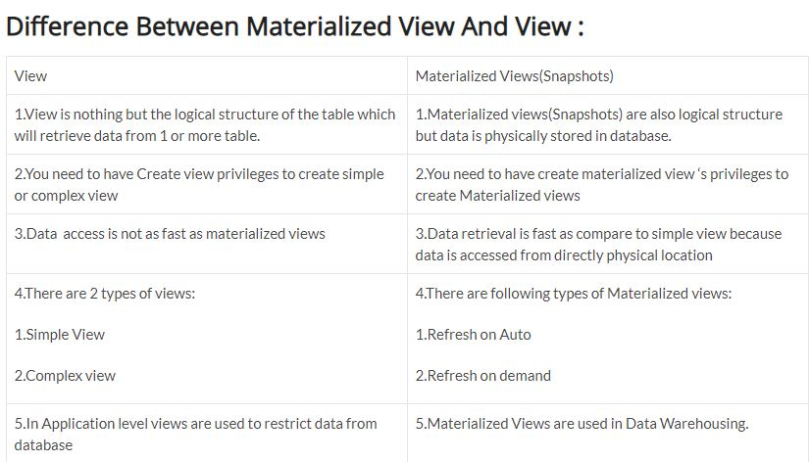

Slide 6
Basics of Transactions
A transaction consists of a sequence of query and/or update statements. The SQL standard specifies that a transaction begins implicitly when an SQL statement is executed.
Unit of work
Atomic transaction
either fully executed or rolled back as if it never occurred
Transactions begin implicitly
Ended by commit work : commits the current transaction; that is, it makes the updates performed by the transaction become permanent in the database
rollback work: causes the current transaction to be rolled back; that is, it undoes all the updates performed by the SQL statements in the transaction.
(note: detail discussion on transaction will revisit later)

Slide 7
Integrity Constraints
Integrity constraints guard against accidental damage to the database, by ensuring that authorized changes to the database do not result in a loss of data consistency.
FOR EXAMPLE:
A checking account must have a balance greater than $10,000.00
A salary of a bank employee must be at least $4.00 an hour
A customer must have a (non-null) phone number

Slide 8
Integrity constraints are usually identified as part of the database schema design process, and declared as part of the create table command used to create relations.
However, integrity constraints can also be added to an existing relation by using the command alter table table-name add constraint, where constraint can be any constraint on the relation.
When such a command is executed, the system first ensures that the relation satisfies the specified constraint.
If it does, the constraint is added to the relation; if not, the command is rejected.

Slide 9
Integrity Constraints on a Single Relation
not null
primary key
unique
check (P), where P is a predicate

Slide 10
Not Null and Unique Constraints
Primary Key Constraint: When this constraint is associated with the column of a table it will not allow NULL values into the column and it will maintain unique values as part of the table.
not null
Declare name and budget to be not null
name varchar(20) not null budget numeric(12,2) not null

Slide 11
unique ( A₁, A₂, …, A_{m})
Unique Constraint: When this constraint is associated with the column(s) of a table it will not allow us to store a repetition of data/values in the column, but Unique constraint allows ONE NULL value. More than one NULL value is also considered as repetition, hence it does not store a repetition of NULL values also.
The unique specification states that the attributes A1, A2, … Am form a candidate key.
Candidate keys are permitted to be null (in contrast to primary keys).
A constraint that is added immediately next to the column definition is known as a Column-level constraint. All constraints that are added after the columns definition of the table is completed are known as Table-level constraints.

Slide 12
CREATE TABLE employee ( id number(5) PRIMARY KEY, name char(20), dept char(10), age number(2), salary number(10), location char(10) UNIQUE );
A constraint that is added immediately next to the column definition is known as a Column-level constraint. All constraints that are added after the columns definition of the table is completed are known as Table-level constraints.

Slide 13
The check clause
When applied to a relation declaration, the clause check(P) specifies a predicate P that must be satisfied by every tuple in a relation.
check (P), where P is a predicate

Slide 14
Example: ensure that semester is one of fall, winter, spring or summer:
create table section (
course_id varchar (8),
sec_id varchar (8),
semester varchar (6),
year numeric (4,0),
building varchar (15),
room_number varchar (7),
time slot id varchar (4),
primary key (course_id, sec_id, semester, year),
check (semester in (’Fall’, ’Winter’, ’Spring’, ’Summer’)) );

Slide 15
Referential Integrity
Ensures that a value that appears in one relation for a given set of attributes also appears for a certain set of attributes in another relation.
Example: If “Biology” is a department name appearing in one of the tuples in the instructor relation, then there exists a tuple in the department relation for “Biology”.
Let A be a set of attributes. Let R and S be two relations that contain attributes A and where A is the primary key of S. A is said to be a foreign key of R if for any values of A appearing in R these values also appear in S.

Slide 16
When a referential-integrity constraint is violated, the normal procedure is to reject the action that caused the violation (that is, the transaction performing the update action is rolled back).
However, a foreign key clause can specify that if a delete or update action on the referenced relation violates the constraint, then, instead of rejecting the action, the system must take steps to change the tuple in the referencing relation to restore the constraint

Slide 17
Cascading Actions in Referential Integrity
create table course ( … dept_name varchar(20), foreign key (dept_name) references department on delete cascade on update cascade, . . . )

Slide 18
Because of the clause on delete cascade associated with the foreign-key declaration, if a delete of a tuple in department results in this referential-integrity constraint being violated, the system does not reject the delete.
Instead, the delete “cascades” to the course relation, deleting the tuple that refers to the department that was deleted.
Similarly, the system does not reject an update to a field referenced by the constraint if it violates the constraint; instead, the system updates the field dept name in the referencing tuples in course to the new value as well.
alternative actions to cascade: set null, set default

Slide 19
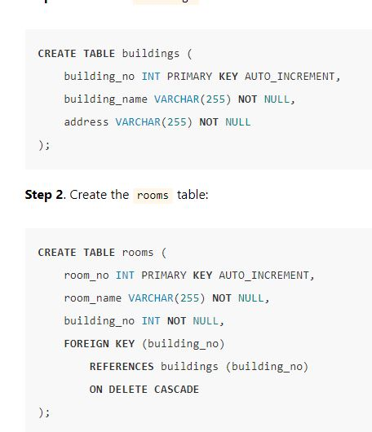

Slide 20
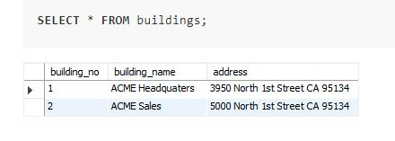
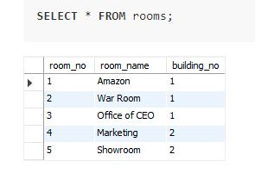

Slide 21
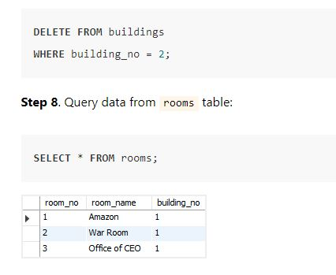

Slide 22
Integrity Constraint Violation During Transactions
E.g.
create table person ( ID char(10), name char(40), mother char(10), father char(10), primary key ID, foreign key father references person, foreign key mother references person)
How to insert a tuple without causing constraint violation ?
insert father and mother of a person before inserting person
OR, set father and mother to null initially, update after inserting all persons (not possible if father and mother attributes declared to be not null)
OR defer constraint checking (next slide)

Slide 23
Complex check clause
As defined by the SQL standard, the predicate in the check clause can be an arbitrary predicate, which can include a subquery.
check (time slot id in (select time slot id from time slot))
The check condition verifies that the time slot id in each tuple in the section relation is actually the identifier of a time slot in the time slot relation.
Thus, the condition has to be checked not only when a tuple is inserted or modified in section, but also when the relation time slot changes (in this case, when a tuple is deleted or modified in relation time slot)

Slide 24
Complex Check Clauses
An assertion is a predicate expressing a condition that we wish the database always to satisfy.
Domain constraints and referential-integrity constraints are special forms of assertions
create assertion <assertion-name> check <predicate>;
Notes:
Triggers - a trigger is a piece of SQL to execute either before or after an update, insert, or delete in a database.
Check Constraint - A check is a piece of SQL which makes sure a condition is satisfied before action can be taken on a record.
Assertions - An assertion is a piece of SQL which makes sure a condition is satisfied or it stops action being taken on a database object.

Slide 25
This SQL statement creates an assertion to demand that there's no more than a single president among the employees:
create assertion AT_MOST_ONE_PRESIDENT as CHECK ((select count(*)
from EMP e
where e.JOB = 'PRESIDENT') <= 1
)

Slide 26
This SQL statement creates an assertion to demand that Boston based departments do not employ trainers:
create assertion NO_TRAINERS_IN_BOSTON as CHECK
(not exists
(select 'trainer in Boston'
from EMP e, DEPT d
where e.DEPTNO = d.DEPTNO
and e.JOB = 'TRAINER'
and d.LOC = 'BOSTON')
)

Slide 27
This SQL statement creates an assertion to demand that vacation records cannot be outside of one's employment period:
create assertion VACATION_DURING_EMPLOYMENT as CHECK (not exists
(select 'vacation outside employment'
from EMP e
,EMP_VACATION ev
where e.EMPNO = ev.EMPNO
and (ev.FIRST_DATE < e.HIRE_DATE or
ev.LAST_DATE > e.TERMINATION_DATE))
)

Slide 28
Make sure that supervisee’s salary is less than his Supervisor’s salary
Create assertion Emp_sal_chek
check(not exists (select * from Employee E1, Employee E2
where E1.Mgr_Id=E2.Emp_Id and
E1.salary>E2.salary) );

Slide 29
For each tuple in the student relation, the value of the attribute tot cred must equal the sum of credits of courses that the student has completed successfully.
create assertion credits earned constraint check
(not exists (select ID from student
where tot cred <> (select sum(credits)
from takes natural join course
where student.ID= takes.ID
and grade is not null and grade<> ’F’ )

Slide 30
Built-in Data Types in SQL
date: Dates, containing a (4 digit) year, month and date
Example: date ‘2005-7-27’
time: Time of day, in hours, minutes and seconds.
Example: time ‘09:00:30’ time ‘09:00:30.75’
timestamp: date plus time of day
Example: timestamp ‘2005-7-27 09:00:30.75’
interval: period of time
Example: interval ‘1’ day
Subtracting a date/time/timestamp value from another gives an interval value
Interval values can be added to date/time/timestamp values

Slide 31
Index Creation
create table student (ID varchar (5), name varchar (20) not null, dept_name varchar (20), tot_cred numeric (3,0) default 0, primary key (ID))
create index studentID_index on student(ID)
Indices are data structures used to speed up access to records with specified values for index attributes
e.g. select * from student where ID = ‘12345’
can be executed by using the index to find the required record, without looking at all records of student
More on indices in Chapter 11

Slide 32
User-Defined Types
create type construct in SQL creates user-defined type
create type Dollars as numeric (12,2)
create table department (dept_name varchar (20), building varchar (15), budget Dollars);

Slide 33
Domains
create domain construct in SQL-92 creates user-defined domain types
create domain person_name char(20) not null
Types and domains are similar. Domains can have constraints, such as not null, specified on them.
create domain degree_level varchar(10) constraint degree_level_test check (value in (’Bachelors’, ’Masters’, ’Doctorate’));

Slide 34
Large-Object Types
Large objects (photos, videos, CAD files, etc.) are stored as a large object:
blob: binary large object -- object is a large collection of uninterpreted binary data (whose interpretation is left to an application outside of the database system)
clob: character large object -- object is a large collection of character data
When a query returns a large object, a pointer is returned rather than the large object itself.

